Slide 1

Data Scientist
ProjeCt 3
Prepare data for a public health organization
Is it possible to suggest values for certain fields when adding a new product to the database ?

Slide 2
Agenda
I. Data exploration
II. Data cleaning
III. Outliers detection
IV. Missing values imputation
V. Completed dataset analysis
VI. Conclusion

Slide 3
I
Data exploration

Slide 4
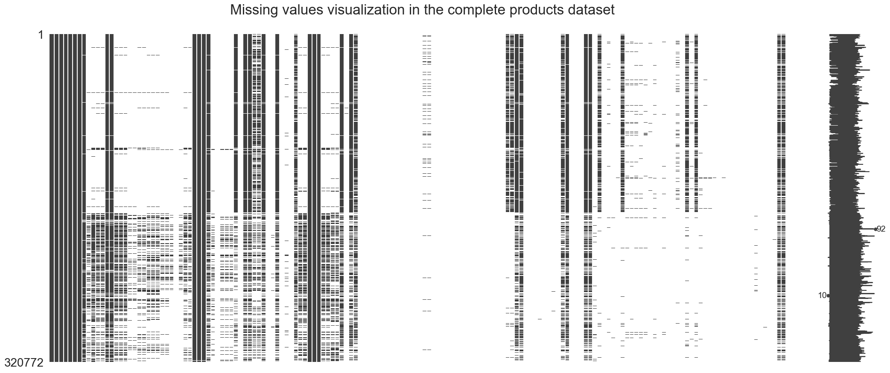
Data exploration
320 772 rows (products) and 162 columns (nutrients, product category, ingredients, general information, …)
Insights
A lot of missing values
Some of the string columns are not standardized
Some of the string columns are actually list-like columns
Duplicated columns (countries, countries_fr, countries_tags)
Even normalized columns (ending with « _tags ») are not perfect

Slide 5
II
Data cleaning

Slide 6
Data cleaning
Basic cleaning
Target choice and filtering
Normalization and clustering
Removed some products with mixed columns
Replaced some values ("unknown", "null", "unavailable", …) with NaN
Removed 21 empty columns
Removed obvious duplicated columns
Example: countries, countries_fr, countries_tags
Removed correlated features
The ones not bringing relevant additional information
Target = pnns_groups_2 (77% missing / 36 unique values)
Normalization
Clustering
Setting to lowercase, removing accents, underscores, consecutive whitespaces, etc
String similarity (like Levenshtein distance)
DBSCAN
Only keep products for which we have data for the target 248 882 products removed
Only keep features with sufficient data 106 columns removed
Drop duplicated products 2 822 products removed
Remove columns that are considered useless to predict the chosen target 8 columns removed

Slide 7
III
Outliers detection

Slide 8
Outliers detection
A nutrient amount cannot exceed 100g
By definition for 100g of food
Sum of macronutrients cannot exceed 100g
By definition for 100g of food
Sugars amount cannot exceed carbs amount
Sugars are included in carbs
Sat. fats amount cannot exceed fats amount
Sat. fats are included in fats
Energy cannot exceed maximum energy
Pure fat is 900 kcal

Slide 9
IV
Missing values imputation

Slide 10
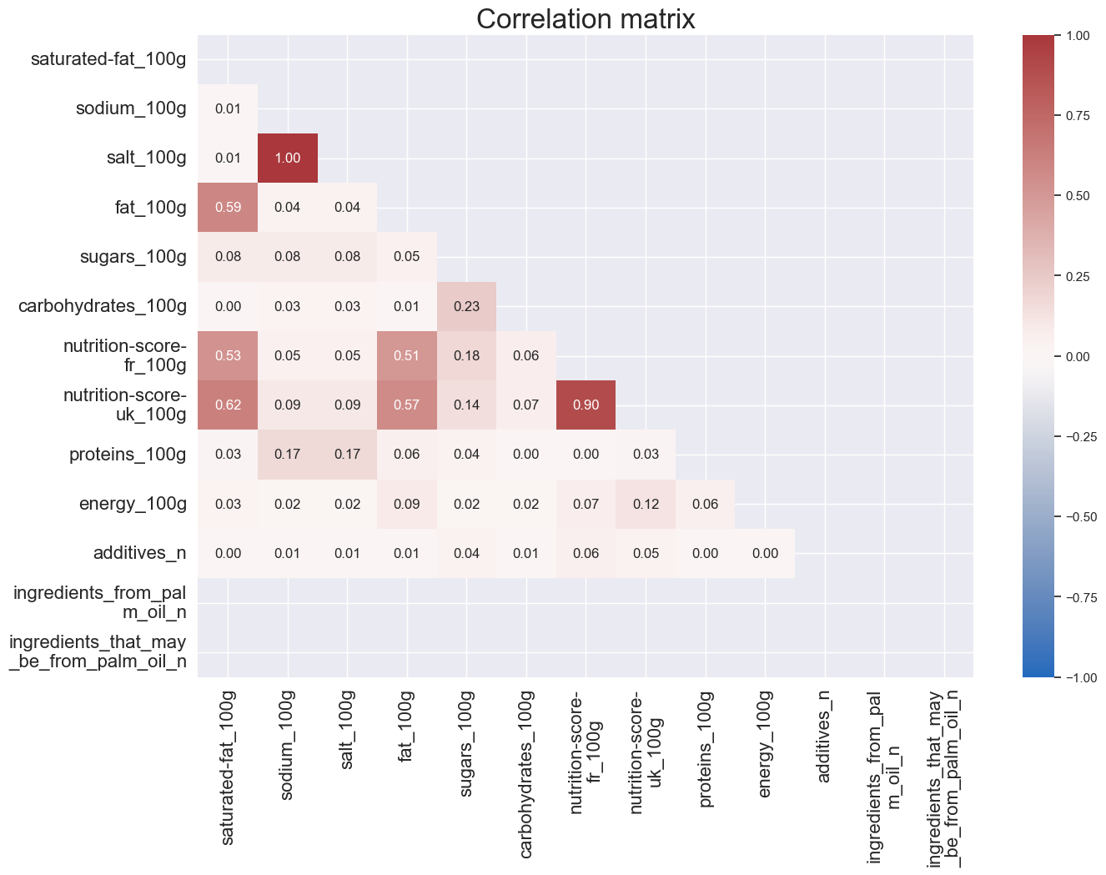
Missing values imputation
Linear regression
Conditions
Important correlation (R > 0.9)
At least 100 data points
Relevance
Very little data to predict
Cleaning
Remove correlated features

Slide 11
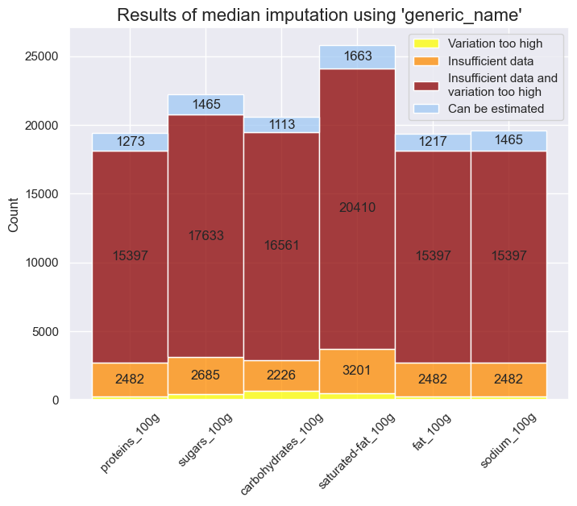
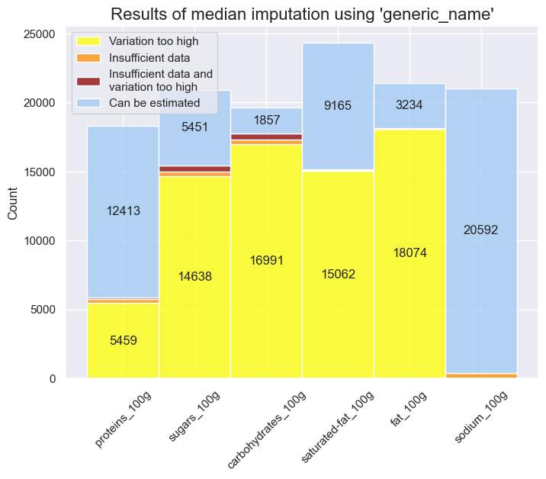
Missing values imputation
Median imputation (nutrients columns)
Using « generic_name »
Using « main_category »
Conditions
Low variance (std < 3)
At least 10 data points
Conditions
Low variance (std < 3)
At least 20 data points

Slide 12
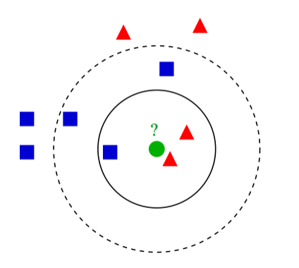
Missing values imputation
K-Nearest Neighbors
Custom metric to calculate the distance
String similarity (Levenshtein like)
List similariry
Basic difference for numbers
→ Euclidian distance
Presence of string data
 | Generic name | Ingredients | Energy
 | Tomato sauce | salt, tomato, sugar, flavour | 379
 | Tomato ketchup | tomato, water, concentrated tomato | 278
Distance | 38% | 71% | 101

Slide 13
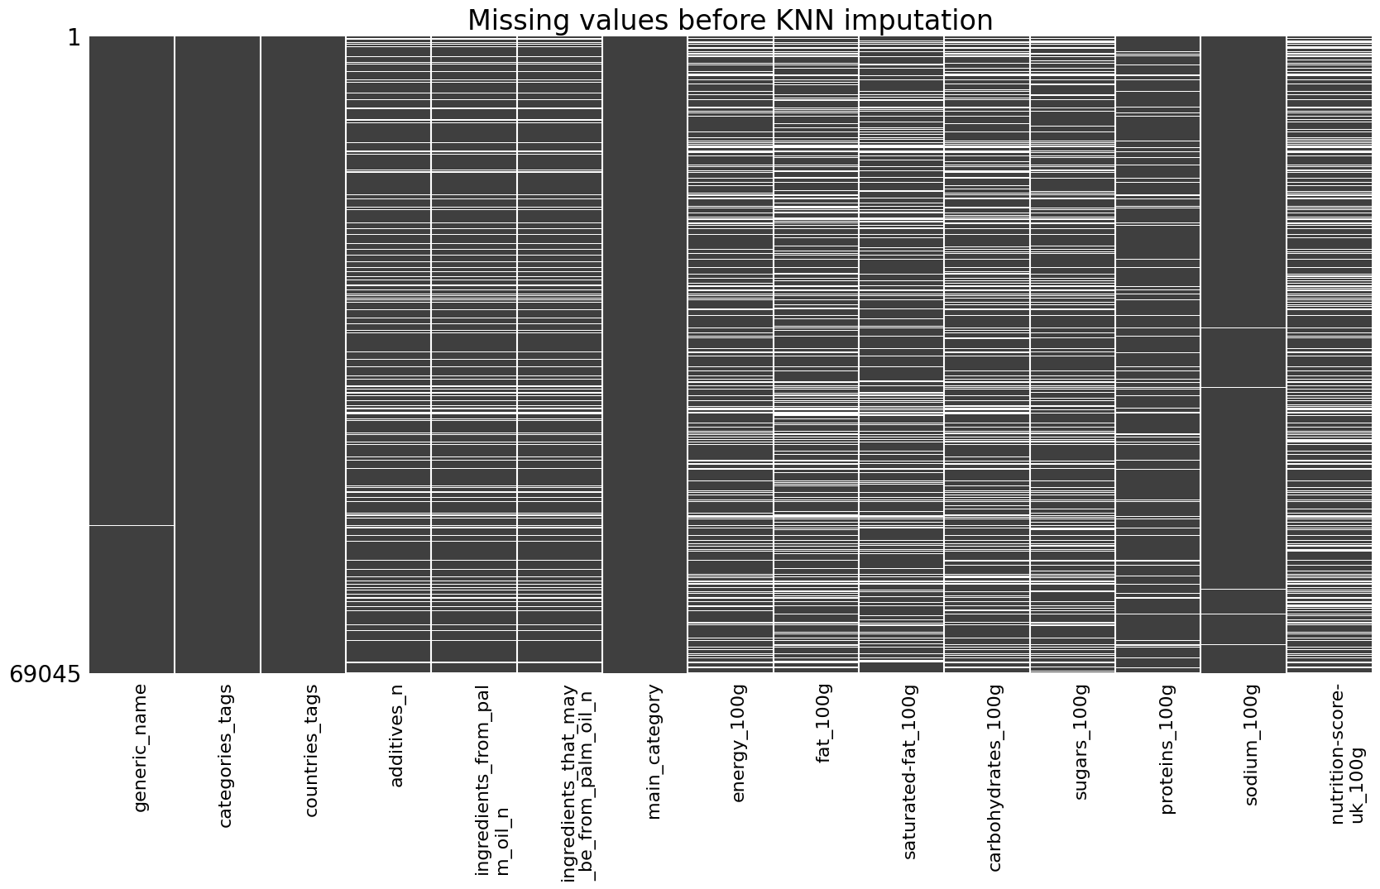
Missing values imputation
K-Nearest Neighbors and remaining missing values

Slide 14
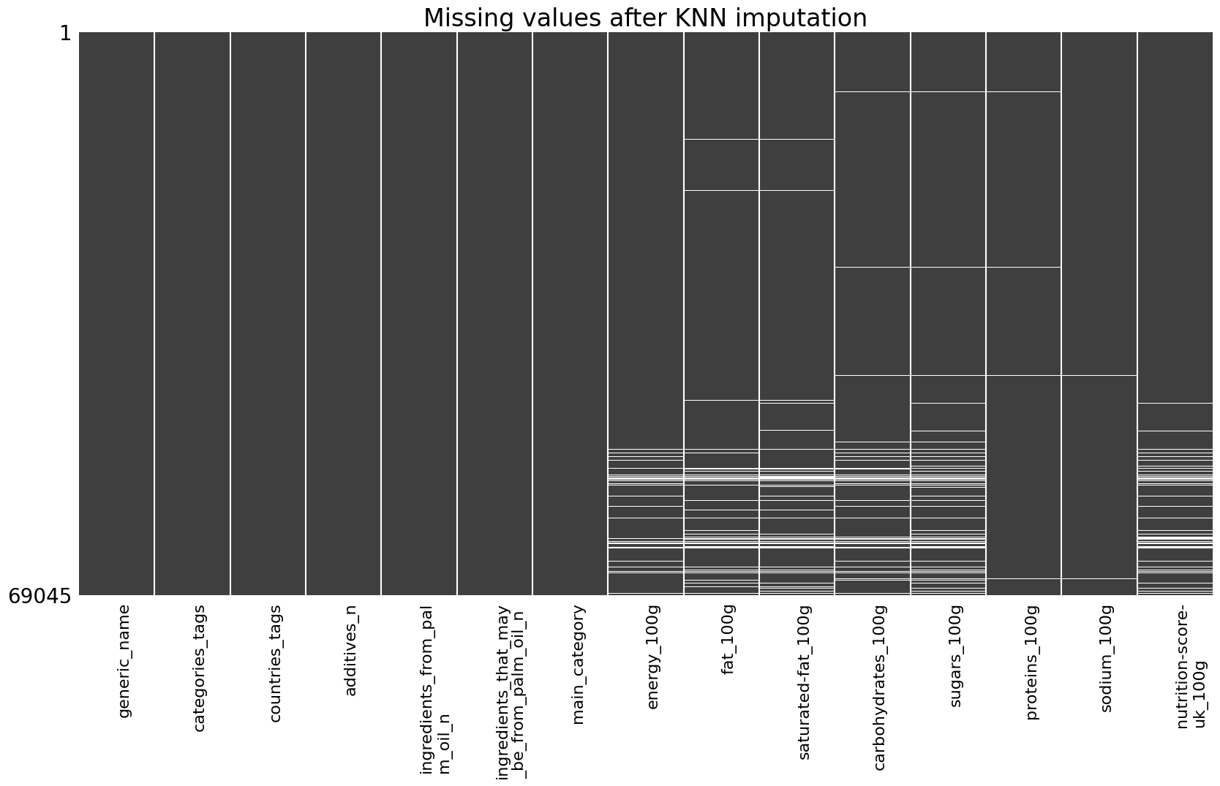
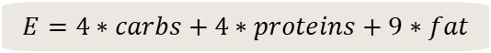
Missing values imputation
K-Nearest Neighbors and remaining missing values
Completing remaining values
Nutrients + nutrition score
using median imputation with « main_category »
Conditions
Low variance (std < 3)
At least 5 data points
Energy using specific rule
$$E=4∗carbs+4∗proteins+9∗fat$$

Slide 15
V
CompleteD dataset analysis

Slide 16
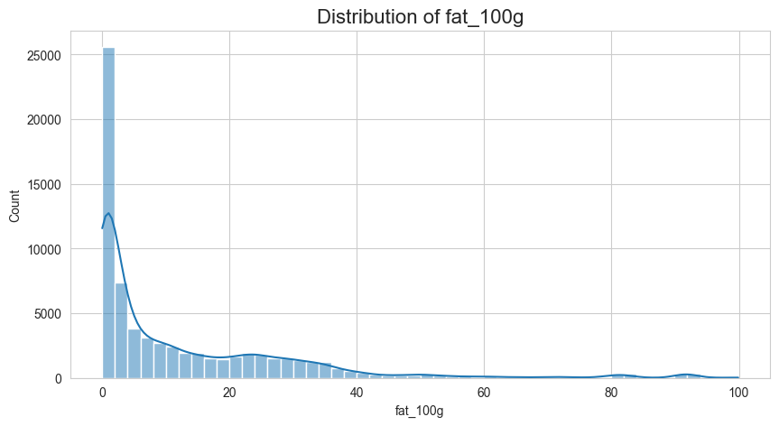
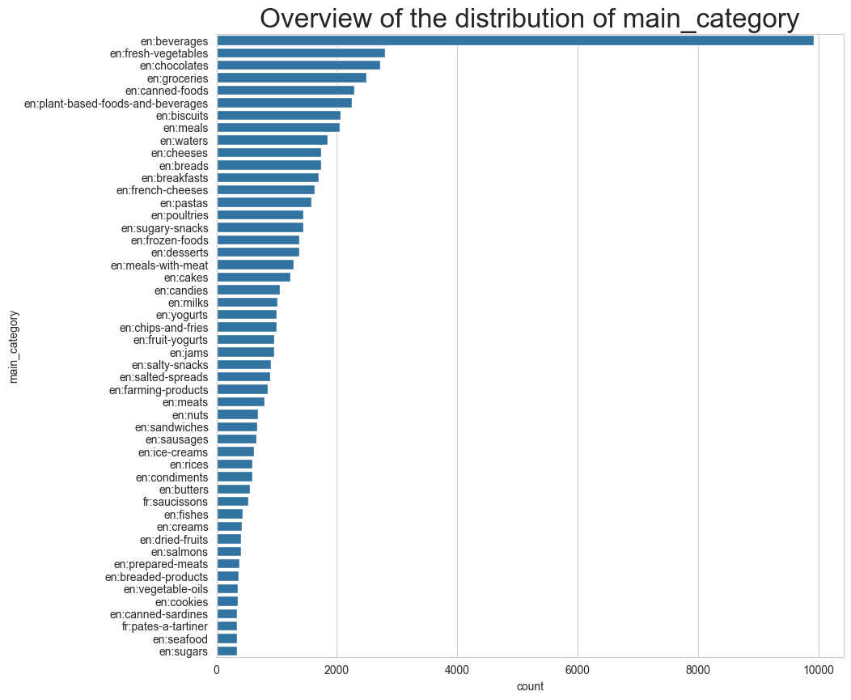
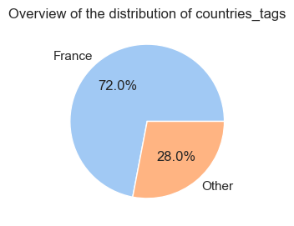
CompleteD dataset analysis
Univariate analysis overview

Slide 17
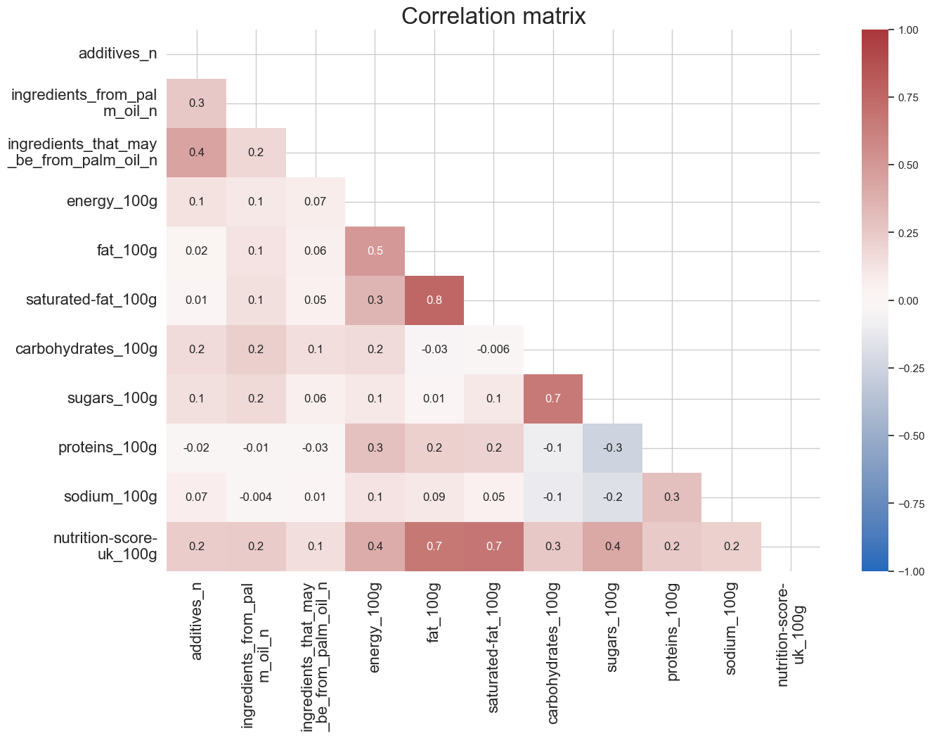
CompleteD dataset analysis
Bivariate analysis overview

Slide 18
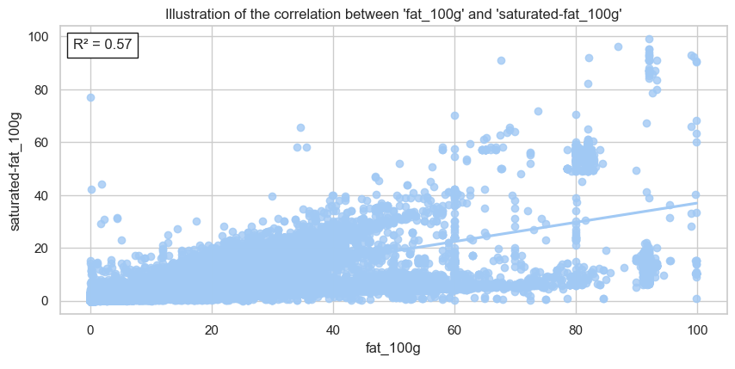
CompleteD dataset analysis
Bivariate analysis overview

Slide 19
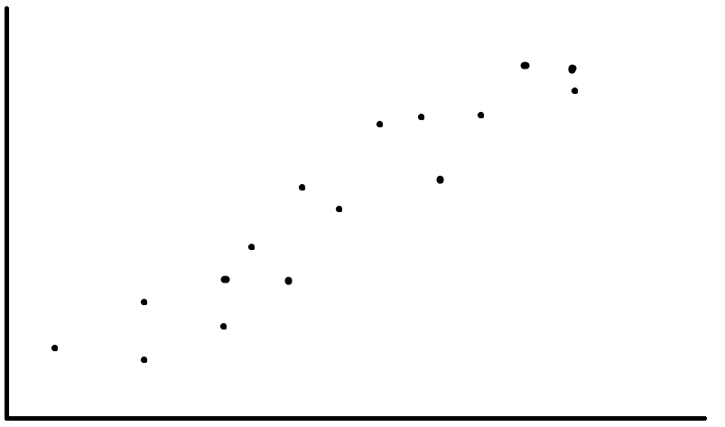
CompleteD dataset analysis
Multivariate analysis: PCA

Slide 20
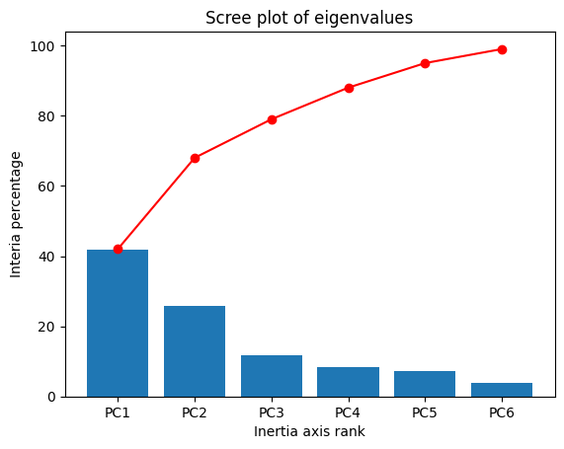
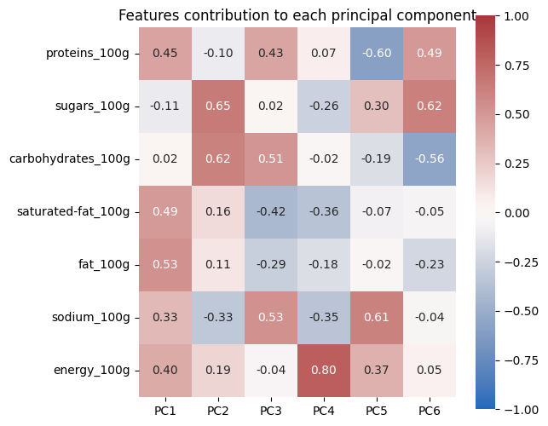
CompleteD dataset analysis
Multivariate analysis: PCA

Slide 21
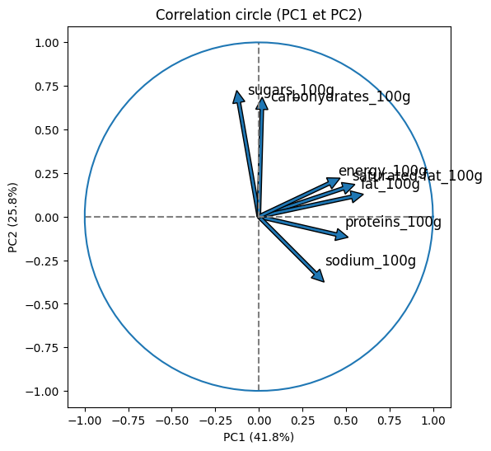
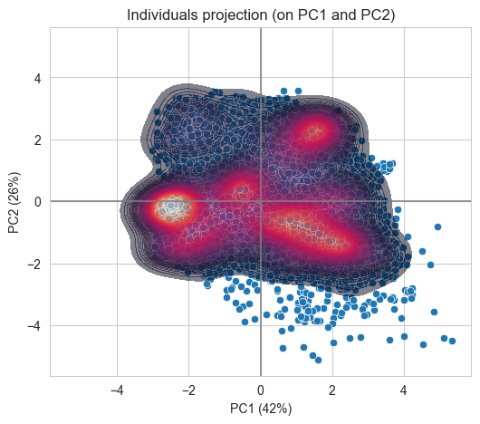
CompleteD dataset analysis
Multivariate analysis: PCA

Slide 22
VI
conclusion

Slide 23
Alternatives & Possible improvements
Remove products with most missing values
In order to avoid questionable imputation methods after KNN, and reduce the distances computation time
Use other features
Results
Quantity units for example, which might be quite easy to impute
Running KNN on less features
Got a complete dataset to perform ML training for suggestions
BUT
Accuracy of imputation is limited
Dataset might not be representative of the overall data.
Still some outliers to handle
Might lead to better results
Apply weights in the distance calculation
Might make the neighbors search more accurate but might also be hard to tweek by hand

Slide 24
Thank you
Maxime Carré

Slide 25
VII
appendix

Slide 26
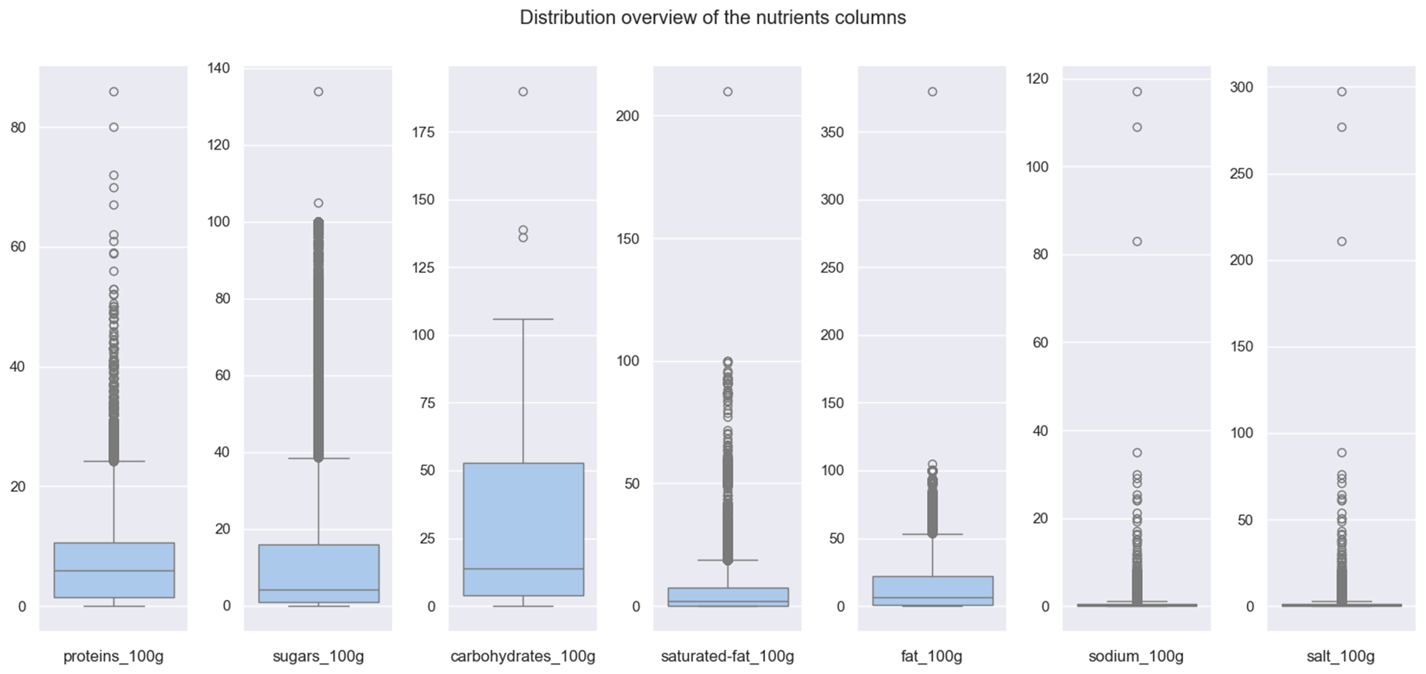
Outliers detection

Slide 27

Outliers detection

Slide 28
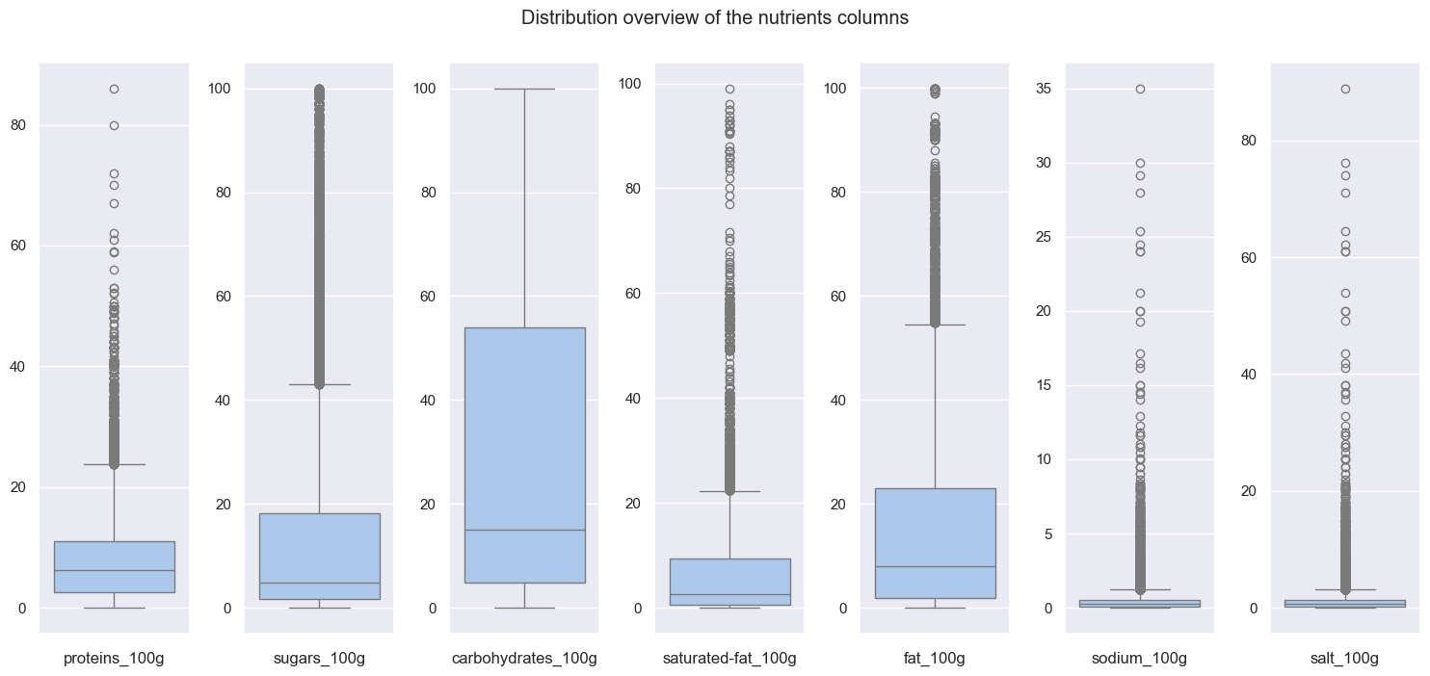
Outliers detection

Slide 29
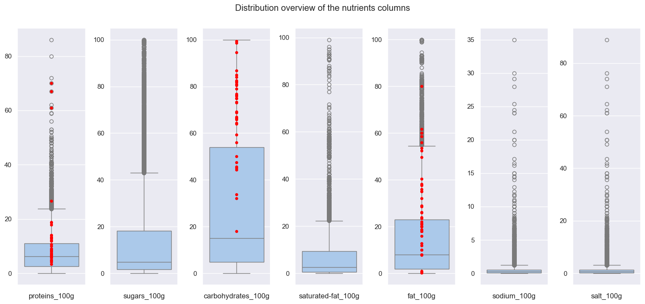
Outliers detection

Slide 30

Outliers detection

Slide 31
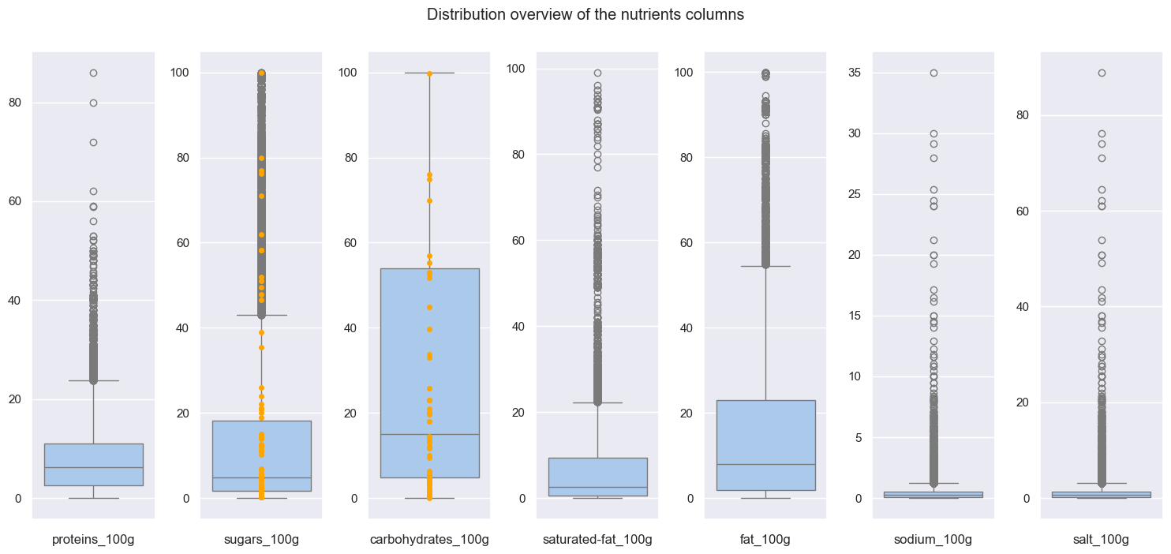
Outliers detection

Slide 32
Outliers detection

Slide 33
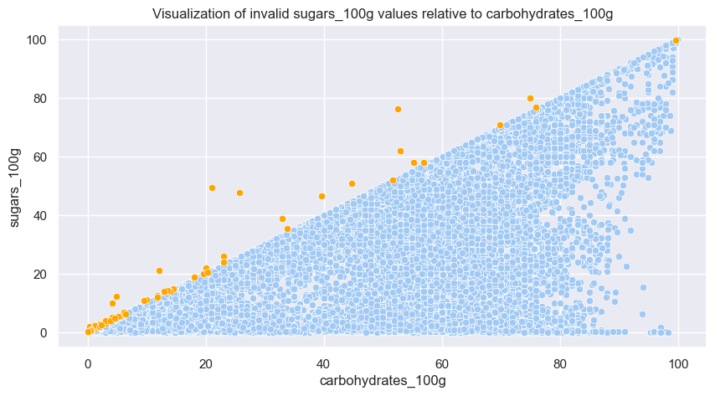
Outliers detection

Slide 34
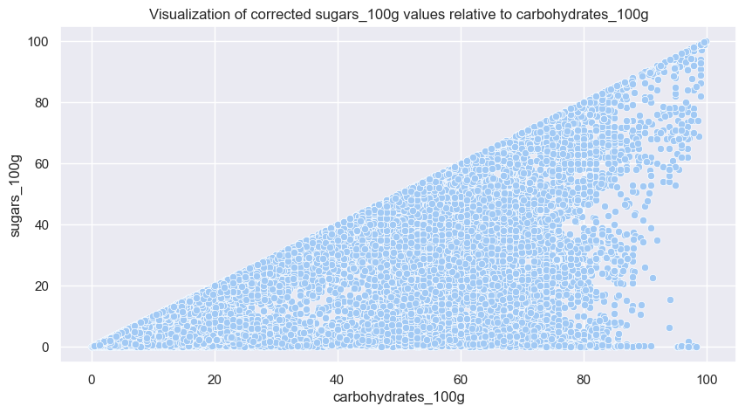
Outliers detection

Slide 35
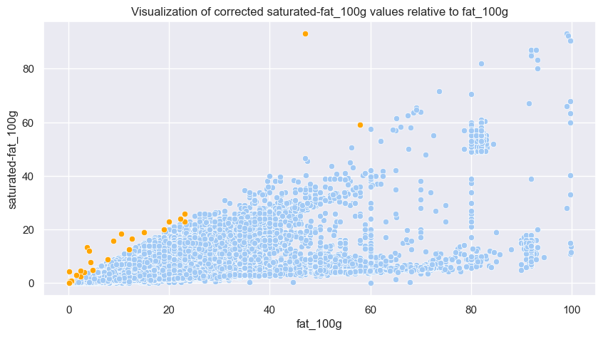
Outliers detection

Slide 36
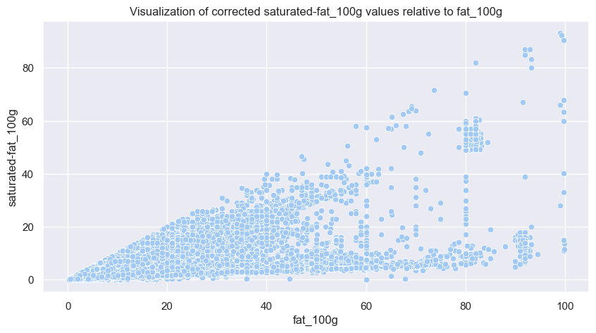
Outliers detection

Slide 37
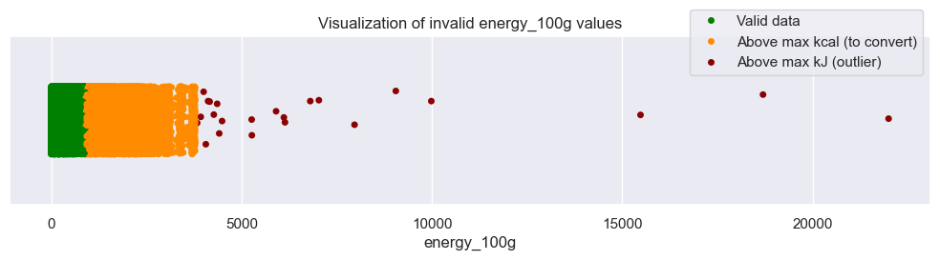
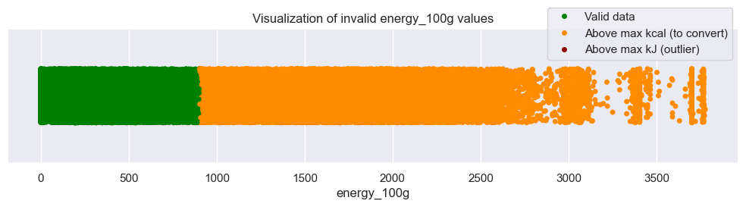
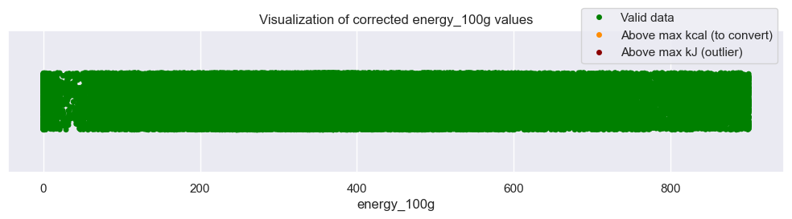
Outliers detection

Slide 38
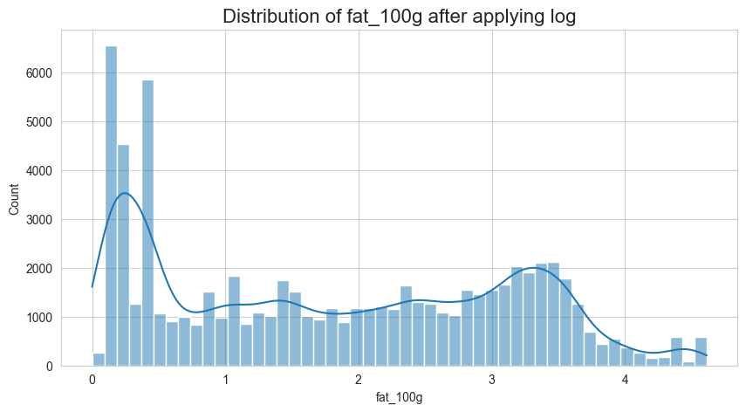
CompleteD dataset analysis
Multivariate analysis: PCA – Applying log to normalize data

Slide 39
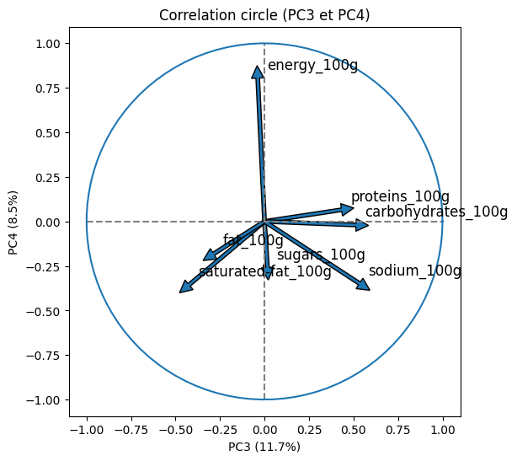
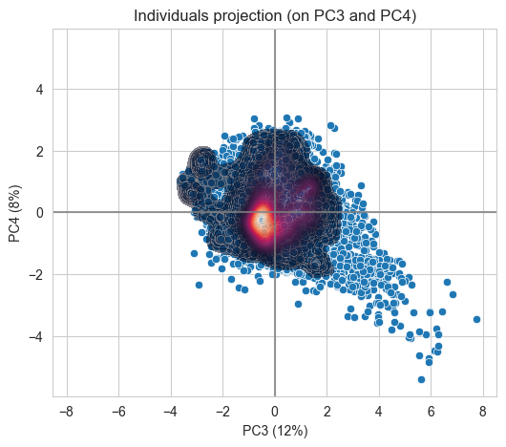
CompleteD dataset analysis
Multivariate analysis: PCA

